Slide 1
Malware Analysis
Dr. Tran The Son
Vietnam – Korea University

Slide 2
Disassembly
Level of Abstraction
  Hardware
    Physical; electronical circuits; logic gates (AND, OR, ..)
  Firmware (microcode)
    Only operates on the designed circuit
    Set of micro-instructions translated from high machine code level to interact with hardware
  Machine code
    Hexadecimal digits (Opcodes) generated when high-level language compiled.
    Underlying hardware can execute (+ microcode)
  Low-level languages
    Human-readable version of a computer architecture's instruction set (e.g. assembly language: mov, jmp, etc.)

Slide 3
Disassembly
  High-level languages
    C, C++
  Interpreted languages
    C#, Perl,. NET, Java, Python
    It is NOT complied into machine-code, translated into Bytecode instead.
    Bytecode executes within an interpreter which translates bytecode into executables machine code on the fly at runtime.
    Reduce the dependence on hardware and OS.
    Can run on VM, e.g. JVM

Slide 4
Disassembly
Level of Abstraction
Malware writer
High-level language
Malware analyst
Low-level language
int c;
printf(“Hello World\n”);
return 0;
push ebp
move ebp, esp
sub esp, 0x40
CPU
Machine code
Complier
Disassembler
(Reverse-Engineering)
55
8B EC
8B EC 40

Slide 5
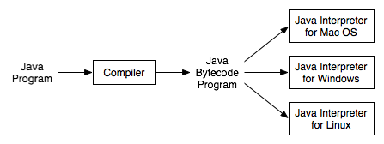
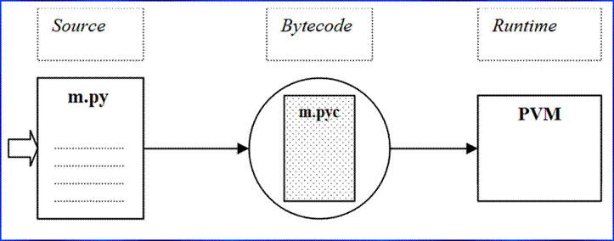
Disassembly

Slide 6
X86 Disassembly
X86 Architecture ALU: Arithmetic Logic Unit
  Von Neumann architecture
CPU
Registers
Main memory
Main
Memory
RAM
LMA
Stack
ALU
Control Unit
Heap
Code
I/O Devices
HMA
Data
Notes:
Data This term can be used to refer to a specific section of memory called the data section, which contains values that are put in place when a program is initially loaded. These values are sometimes called static values because they may not change while the program is running, or they may be called global values because they are available to any part of the program.
Code Code includes the instructions fetched by the CPU to execute the program’s tasks. The code controls what the program does and how the program’s tasks will be orchestrated.
Heap The heap is used for dynamic memory during program execution, to create (allocate) new values and eliminate (free) values that the program
no longer needs. The heap is referred to as dynamic memory because its contents can change frequently while the program is running.
Stack The stack is used for local variables and parameters for functions, and to help control program flow.

Slide 7
X86 Disassembly
Data This term can be used to refer to a specific section of memory called the data section, which contains values that are put in place when a program is initially loaded. These values are sometimes called static values because they may not change while the program is running, or they may be called global values because they are available to any part of the program.
Code Code includes the instructions fetched by the CPU to execute the program’s tasks. The code controls what the program does and how the program’s tasks will be orchestrated.
Heap The heap is used for dynamic memory during program execution, to create (allocate) new values and eliminate (free) values that the program no longer needs. The heap is referred to as dynamic memory because its contents can change frequently while the program is running.
Stack The stack is used for local variables and parameters for functions, and to help control program flow.

Slide 8
X86 Disassembly
Instruction
Opcodes and Endianness
Operands
    Immediate: 0x42
    Register: ecx
    Memory address: [eax]
Mnemonic | Dest.. Operand | Source operand
mov | ecx | 0x42
Instruction | Mov ecx | 0x42
Opcodes | B9 | 42 00 00 00
https://www.cs.uaf.edu/2016/fall/cs301/lecture/09_28_machinecode.html

Slide 9
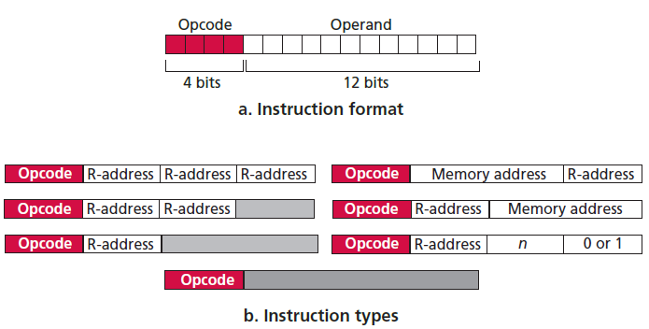
X86 Disassembly

Slide 10
X86 Disassembly
Registers: a small amount of data storage in CPU
General register |  | Segment register | Status register (flag) | Instruction pointer
EAX (AX,AH, AL) | 000 (0) | CS | EFLAGS | EIP
EBX (BX, BH, BL) | 011 (3) | SS
ECX (CX, CH, CL) | 001 (1) | DS
EDX (DX, DH, DL) | 010 (2) | ES
EBP (BP) | 101 (5) | FS
ESP (SP) | 100 (4) | GS
ESI (SI) | 110 (6)
EDI (DI) | 111 (7)
Notes:
. General registers are used by the CPU during execution (AX: accumulator; DX: double word accumulator; CX: counter; BX: base register; SI-DI: source-destination index).
● Segment registers are used to track sections of memory.
● Status flags are used to make decisions.
● Instruction pointers are used to keep track of the next instruction to execute.

Slide 11
X86 Disassembly
Registers
EAX
1010
A
1001
9
1101
D
1100
C
1000
8
0001
1
1111
F
0101
5
32 bits
AX
1000
8
0001
1
1111
F
0101
5
16 bits
AH
AL
1000
8
0001
1
1111
F
0101
5
8 bits

Slide 12
X86 Disassembly
Flags
  ZF: zero flag
  SF: sign flag
  CF: carry flag
  TF: trap flag
  OF: overflow
  …..
Instruction Pointer
  EIP: contains the memory address of the next instruction to be executed -> tells CPU what to do next
When EIP is corrupted, the CPU will not be able to fetch legitimate code to execute, therefore the program running at the time will likely crash. When you control EIP, you can control what is executed by the CPU.

Slide 13
X86 Disassembly
Simple instructions
Instruction | Description
mov eax, ebx
mov eax, 0x40
mov eax, [0x4037c4]
mov eax, [ebx]
mov eax, [ebx+esi*4]
lea eax, [ebx+8]
sub eax, 0x10
add eax, ebx
Instruction | Description
inc edx
dec ecx
mul eax, 0x50
div ebx, 0x75
xor eax, eax
shl eax, 2
ror
nop

Slide 14
X86 Disassembly
Conditionals: instructions that perform the comparison, i.e. test, cmp
    Uses with flags ZF, CF, …
cmp dst, src
test dst, src
cmp | ZF | CF
Dst = src | 1 | 0
Dst < src | 0 | 1
Dst > src | 0 | 0

Slide 15
X86 Disassembly
Branching: a sequence of code that is conditionally executed depending on the flow of the program, i.e. jmp and many versions
Instruction | Description
jz loc | ZF=1 (ss đúng)
jnz loc | ZF=0 (ss sai)
jne loc | !=
jg loc | >
jge loc | >=
ja loc | Jg, unsinged
jae loc | Jge, unsigned
jl loc | <
Instruction | Description
jle loc | <=
jb loc | Jl, unsinged
jbe loc | Jle, unsigned
jo loc | Overflow flag OF=1
js loc | Sign flag SF=1
jecxz loc | ECX = 0

Slide 16
X86 Disassembly
Rep (repeat – until ECX=0)
    ESI, EDI used for source and dest. index
    ECX used as a counter.
    Repeat until ECX = 0 or ZF = 1 (or 0)
Instruction | Description
rep | Repeat until ECX = 0
repe, repz | Repeat until ECX = 0 or ZF = 0
repne, repnz | Repeat until ECX = 0 or ZF = 1

Slide 17
X86 Disassembly
Rep (repeat – until ECX=0)
Instruction | Description
repe cmpsb | Compare to data buffers. ESI, EDI are buffers’ locations. Repeat until ECX = 0
rep stosb | Initialize all bytes of a buffer to a certain value
rep movsb | Copy a buffer of bytes. Repeat until ECX = 0 or ZF = 1
repne scasb | Search a data buffer for a single byte. Repeat until ECX=0 or byte not found.

Slide 18
X86 Disassembly
The Stack: LIFO structure for storing
    Local variables of functions
    Parameters of functions
    Flow control of the program
      Return Address
  Uses registers
    ESP: stack pointer
      Address of the top of the stack
    EBP: base pointer
      Keep track of the location of local variables and parameters
  Instructions
    Enter, push, pop, call, leave, ret
Low Memory Address
Current Stack Frame
Caller’s Stack Frame
Caller’s Caller’s Stack Frame
High Memory Address
Notes:
Enter: setup a new stack frame for a procedure
Leave: used at the end of the procedure (just before the RET instruction) to release the stack frame (pop EBP off, set ESP = EBP).
Ret: return the calling function (pop Return addr → EIP)

Slide 19
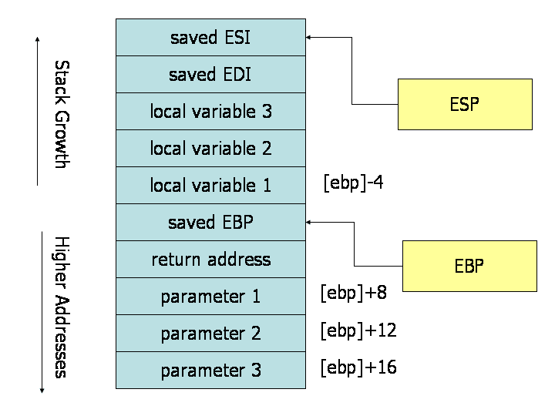
X86 Disassembly
The Stack → Function call procedure
  1. Push arguments into the stack;
  2. Call function;
    Call [memory location]
    Push return address
  3. Allocate space for local variable
  & Set base pointer EBP
  4. Perform function → EAX
  5. Restore stack to be free
  Leave instruction (set ESP=EBP)
  6. Return to the previous (original)
  Ret instruction (pop Return addr. to EIP)
  7. Remove arguments

Slide 20
X86 Disassembly
Function call example
push c
push b
push a
call test
add esp, 12
mov result, eax
int test(int x, int y, int z);
int a, b, c, result;
result = test(a, b, c);

Slide 21
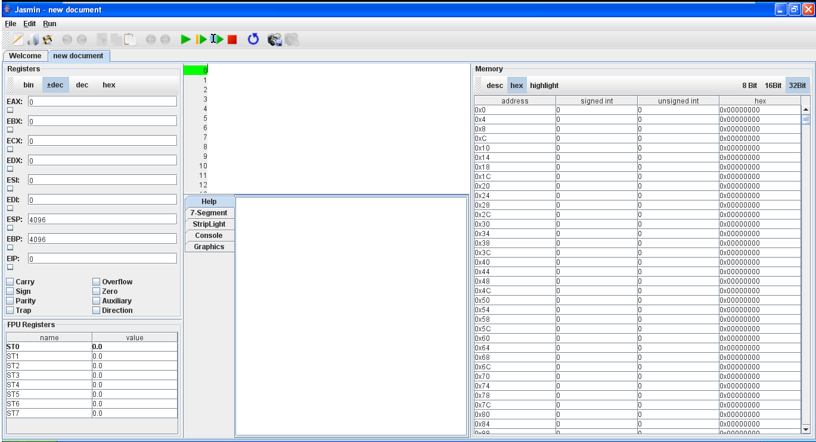
Practice [Assembly by Jasmin app.]
Practice “Simple Instructions”
Code
Registers
Memory
Flags
Help
Download Jasmin at: https://sourceforge.net/projects/tum-jasmin/files/

Slide 22
Practice Jasmin
Storing results in Memory
mov eax, 4
mov ebx, 6
mov [eax], ebx
mov ecx, eax
add ecx, ebx
mov [eax+4], ecx
Using Stack
mov eax, 4
mov ebx, 6
push eax
push ebx
pop ecx
Reversing a sequence
Eax, ebx, ecx, edx = 1,2,3, 4
-> Eax, ebx, ecx, edx = 4,3,2,1
?
?
ESP
EBP
EIP
EAX
EBX
ECX
?

Slide 23
X86 Disassembly
C Main Method and Offsets
004113CE cmp [ebp+argc], 3
004113D2 jz short loc_4113D8
004113D4 xor eax, eax
004113D6 jmp short loc_411414
004113D8 mov esi, esp; save ESP value
004113DA push 2 ; MaxCount
004113DC push offset Str2 ; "-r"
004113E1 mov eax, [ebp+argv]
004113E4 mov ecx, [eax+4]; agrv[1]
004113E7 push ecx ; Str1
004113E8 call strncmp ; return to EAX
004113F8 test eax, eax
004113FA jnz short loc_411412; 004113FC mov esi, esp
004113FE mov eax, [ebp+argv]
00411401 mov ecx, [eax+8]
00411404 push ecx ; lpFileName
00411405 call DeleteFileA
program.exe -r filename.txt
int main(int argc, char* argv[])
{
  if (argc != 3) {return 0;}
  if (strncmp(argv[1], "-r", 2) == 0){
  DeleteFileA(argv[2]);
}
return 0;
}
Notes:
argv stands for argument vector
argc for argument count, and
envp for environment pointer.

Slide 24
Viết 1 đoạn Ct như ví dụ
Phân tích mã bằng IDA Pro
int main(int argc, char* argv[])
{
  if (argc != 3) {return 0;}
  if (strncmp(argv[1], "-r", 2) == 0){
  DeleteFileA(argv[2]);
}
return 0;
}

Slide 25
Recognizing C/C++ structure
Local & global variables
Operation +, -, ++, --, %
Condition if
Loop for, while
Function calls
Other: switch, array, structs

Slide 26
Recognizing C/C++ structure
Global & Local variable
int x = 1;
int y = 2;
void main()
{
  x = x+y;
  printf("Total = %d\n", x);
}
00401003 mov eax, dword_40CF60; x
00401008 add eax, dword_40C000; y
0040100E mov dword_40CF60, eax
00401013 mov ecx, dword_40CF60
00401019 push ecx
0040101A push offset aTotalD ;"total = %d\n"
0040101F call printf
00401006 mov dword ptr [ebp-4], 1
0040100D mov dword ptr [ebp-8], 2
00401014 mov eax, [ebp-4]
00401017 add eax, [ebp-8]
0040101A mov [ebp-4], eax
0040101D mov ecx, [ebp-4]
00401020 push ecx
00401021 push offset aTotalD ; "total = %d\n"
00401026 call printf
void main()
{
  int x = 1;
  int y = 2;
  x = x+y;
  printf("Total = %d\n", x);
}

Slide 27
Recognizing C/C++ structure
Operation
00401006 mov [ebp+var_4], 0; a
0040100D mov [ebp+var_8], 1; b
00401014 mov eax, [ebp+var_4]
00401017 add eax, 0Bh
0040101A mov [ebp+var_4], eax
0040101D mov ecx, [ebp+var_4]
00401020 sub ecx, [ebp+var_8]
00401023 mov [ebp+var_4], ecx
00401026 mov edx, [ebp+var_4]
00401029 sub edx, 1
0040102C mov [ebp+var_4], edx
0040102F mov eax, [ebp+var_8]
00401032 add eax, 1
00401035 mov [ebp+var_8], eax
00401038 mov eax, [ebp+var_4]
0040103B cdq ; edx:eax
0040103C mov ecx, 3
00401041 idiv ecx
00401043 mov [ebp+var_8], edx
int a = 0;
int b = 1;
a = a + 11;
a = a - b;
a--;
b++;
b = a % 3;
Notes:
When performing the div or idiv instruction, you are dividing edx:eax by the operand
and storing the result in eax and the remainder in edx.
Cdq => edx:eax

Slide 28
Recognizing C/C++ structure
If statement
00401006 mov [ebp+var_8], 1; x
0040100D mov [ebp+var_4], 2; y
00401014 mov eax, [ebp+var_8]
00401017 cmp eax, [ebp+var_4]
0040101A jnz short loc_40102B
0040101C push offset aXEqualsY_ ; "x equals y.\n"
00401021 call printf
00401026 add esp, 4 ; return to [ebp+var_8]
00401029 jmp short loc_401038
0040102B loc_40102B:
0040102B push offset aXIsNotEqualToY ; "x is not equal to y.\n"
00401030 call printf
int x = 1;
int y = 2;
if(x == y){
printf("x equals y.\n");
}
else{
printf("x is not equal to y.\n");
}

Slide 29
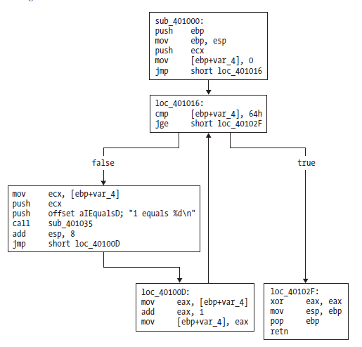
Recognizing C/C++ structure
Loop
00401004 mov [ebp+var_4], 0
0040100B jmp short loc_401016
0040100D loc_40100D:
0040100D mov eax, [ebp+var_4]
00401010 add eax, 1
00401013 mov [ebp+var_4], eax
00401016 loc_401016:
00401016 cmp [ebp+var_4], 64h
0040101A jge short loc_40102F
0040101C mov ecx, [ebp+var_4]
0040101F push ecx
00401020 push offset aID ; "i equals %d\n"
00401025 call printf
0040102A add esp, 8
0040102D jmp short loc_40100D
0040102F loc_40102F:
00401034 xor eax, eax
004010xx mov esp, ebp
004010xx pop ebp
004010xx ret
int i;
for(i=0; i<100; i++)
{
printf("i equals %d\n", i);
}

Slide 30
Recognizing C/C++ structure
Function call
adder
00401730 push ebp
00401731 mov ebp, esp
00401733 mov eax, [ebp+arg_0]
00401736 add eax, [ebp+arg_4]
00401739 pop ebp
0040173A retn
int adder(int a, int b)
{
return a+b;
}
void main()
{
int x = 1;
int y = 2;
printf("the function returned the number %d\n", adder(x,y));
}
00401746 mov [ebp+var_4], 1
0040174D mov [ebp+var_8], 2
00401754 mov eax, [ebp+var_8]
00401757 push eax
00401758 mov ecx, [ebp+var_4]
0040175B push ecx
0040175C call adder
00401761 add esp, 8
00401764 push eax
00401765 push offset TheFunctionRet
0040176A call ds:printf
main

Slide 31
Practice 5 & 6 [IDA Pro]
Introduction to IDA Pro
Examine C structures by IDA Pro
  Lab05-01.dll (skip)
  Lab06-01.exe
  Lab06-02.exe
  Lab06-03.exe
  Lab06-04.exe
Notes:
Lab06-01.exe
What is the major code construct found in main()?
What is the subroutine located at 0x40105F?
What is the purpose of the program?
Lab06-02.exe
What does 1st subroutine called by main() do?
What is the subroutine located at 0x40117F?
What does 2nd subroutine called by main() do?
What is network-based indicators?
What the purpose of the program?
Lab06-03.exe
What is the function called by main()? parameters used? Code construct? purpose
What are host-based indicators?
What is the purpose of the program
Lab06-04.exe
What is different called by main() compared to Lab06-03? New code construct added to main()?
How long will this program run?
What are network-based indicators?
What is the purpose of the program?

